Slide 1

ORDER FORECAST IN OASIS STORE ORDERING PATTERN AND FORECAST
Campus Ambassador Program Hackathon

Slide 2





BRUTE FORCE
Devi Ahilya Vishwavidyalaya
AMAN NAREDI
NIKHIL GEORGE
YASH WADHAWAN

Slide 3


PROBLEM STATEMENT
OVERVIEW
Oasis Store is an internal e-commerce site in VMware to order IT Assets. VMware colleagues
place order using the store of various IT assets like laptops, monitors etc.
EVALUATION
1. Ordering pattern basis various KPI’s
2. Ordering forecast basis various KPI’s
APPROACH
Towards producing an optimized forecasting result keeping in mind the current technical aspects which will enhance the quality of forecasting and producing the desired pattern which will exhibit easy understanding and execution with the intention of minimum usage of inventory and program memory space with faster and efficient outcome.

Slide 4

OUR BIG IDEA
Producing the required pattern starting with data analysis for data cleaning to remove outliers and filling missing values to incorporate the efficiency of the model and visualizing trend and seasonality of data by decomposing the time series to overcome the conventional problem of not considering the future outcome for forecasting but to predict the future outcome as well to produce a middle value with consideration of errors and comparisons to the expectation and to make the time series stationary by removing the time dependency and to stabilize statistical factors of the model like standard deviation and normalizing the data, which in turn will be fed to the mathematical forecasting model to produce desired forecast and ordering pattern.

Slide 5

SOLUTION PROCESS OUTLOOK
DATA ANALYSIS | TIME SERIES ANALYSIS | NORMALIZING DATA | FORECASTING | PATTERN PLOTTING
Cleaning Filling Nans Dropping Nans | Series decomposing Checking stationarity | Reducing varaince | Fitting normalized data to models Linear regression Chatboost ARIMA/ SARIMA RNN, LSTM, BLSTM | Ordering Pattern plot using various data representation tools
SUCCESS

Slide 6

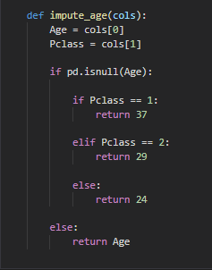
Data analysis
Describing statistical property of data
Checking missing values and if any then,
Filling numerical missing values via,
Mean
Median
Interpolation
If possible, else
removing
the element.
And analyzing
non-numerical
values via
clustering
of common
categories.

Slide 7

Time series analysis
Decomposing series into:
Base level + Trend + Seasonality + error
Then examining the above categories for visualizing any presence of seasonality in data, if any then it is removed to detrend by Differencing and making the Series stationary by (once or more)
-Taking the log of the series
-Taking the nth root of the series
-Combination of the above.
Also depending on the time series it can be modified as additive and multiplicative and then making the mean, variance and auto correlation constant over time considering the previous values
Then performing the stationary test:
-Augmented Dickey Fuller test (ADH Test)
-Kwiatkowski-Phillips-Schmidt-Shin – KPSS test (trend stationary)
-Philips Perron test (PP Test)

Slide 8
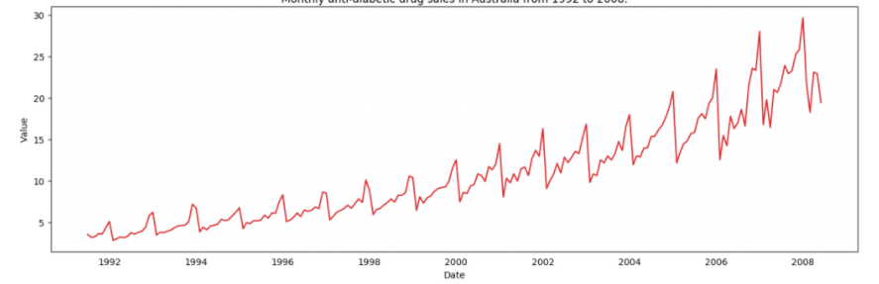
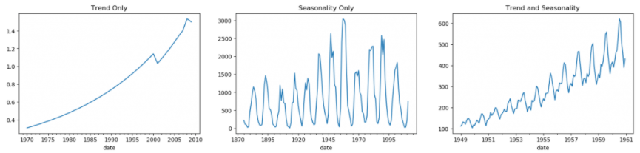
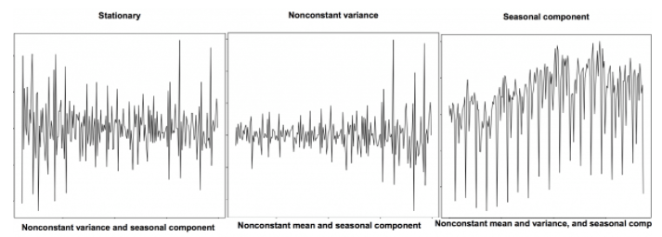
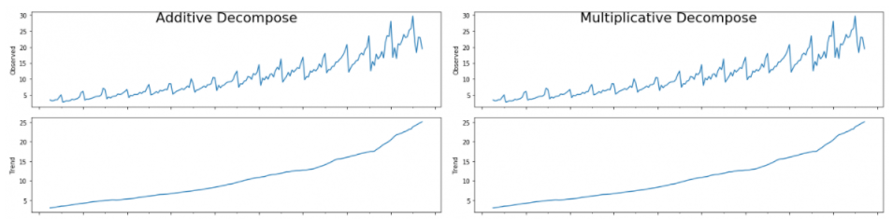
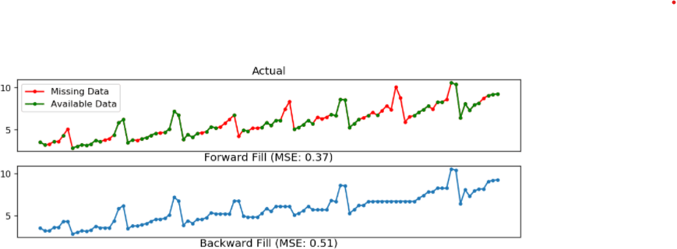
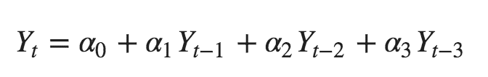
Time series analysis
Visualizing
Pattern
Check for Stationary
Detrending
Missing element
Deseasonlized
Auto correlation
Smoothening

Slide 9
Normalizing data
Normalization also makes the training process less sensitive to the scale of the features. This results in getting better coefficients after training.
This process of making features more suitable for training by rescaling is called feature scaling.
We are going to use standard scaler to directly stabilize the input by,
Using the default configuration and scale values to subtract the mean to center them on 0.0 and divide by the standard deviation to give the standard deviation of 1.0. First, a StandardScaler instance is defined with default hyperparameters.

Slide 10

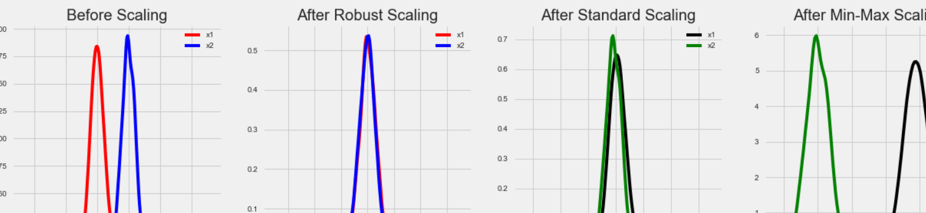
Comparison for normalizing data:
We are using standard scalar

Slide 11
Forecasting
After following the procedure explained in previous slides
We are going to use the following models for predicting the forecast,
Linear Regression model which will be our base model for predicting the threshold value for further implementation. The value here will be compared with other machine learning models, for instance, if the value forecasted by any other method crosses this threshold value then the value will not be taken into consideration and will be evaluated for Hyper tuning. The continuing models include:
Cat boost
ARIMA / SARIMA
RNN, LSTM, BRNN

Slide 12
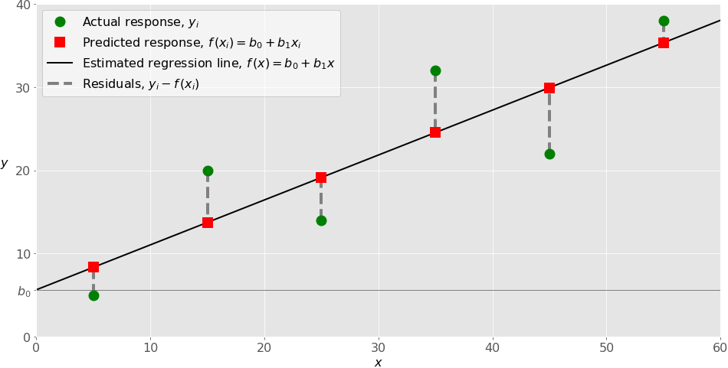
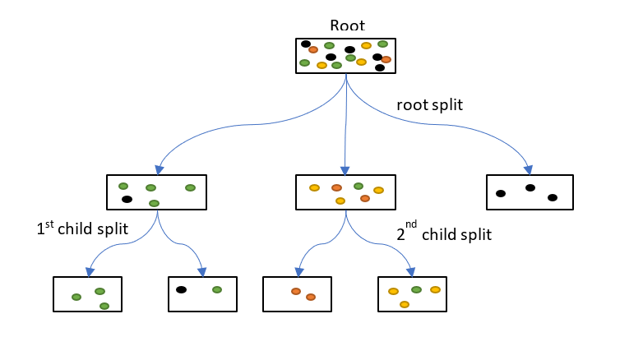
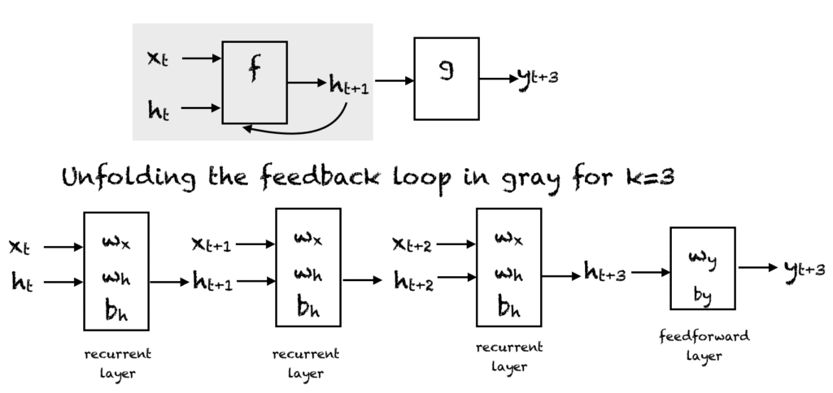
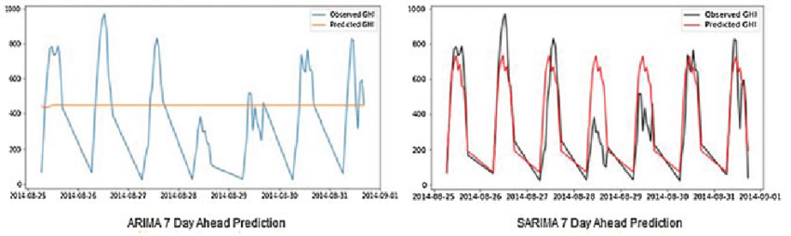
Forecasting using various mathematical models:
Linear Regression (base model)
Cat boost
Threshold compared (t)
If value > t, then hyper tuning
RNN, BRNN, LSTM
ARIMA/SARIMA

Slide 13
Result from forecasting
The final result of the forecasting is produced to produce:
Ordering pattern in form of data representation fed through forecasting model.
Ordering forecast can be produced eventually from the above results with interactive simulations.

Slide 14

Outcomes
Ordering pattern basis various KPI’s
Ordering forecast basis various KPI’s
Following the procedure for solution we will be able to plot the ordering pattern on the basis of various KPI’s by predicting the output and using visual implementation tools such as bar graph, histogram, pie chart etc. for efficient learning.
From the pattern produced and the values obtained a forecasted value can be produced for a particular time period which will not only keep in mind the past activities as well as the future dataset prediction which would eventually help In efficient inventory control and order rate.

Slide 15
Advantages
On the ability of storing historical data that is error free
On the basis of dealing the vanishing gradient problem and future inputs
On the basis of ability to handle data
Following procedure will make sure that the data handled is normalized as well detrend and stationary which is very important when dealing with large amount of data
Since we are using different types of model at once so there is multiple comparisons as well as the data is treated against a standard expected value and is made error free at each step.
Also the dataset treated is smoothened as far as possible before forecasting.
To overcome the problem of future inputs we are going to use the LSTM and Bidirectional RNN.
Since we will be dealing with large amount of data we will provide the weight gradient to the newest values possible and the upcoming future values so as to avoid vanishing gradient.

Slide 16
Limitations
Solution to Limitations
Computation will be slow
Faster application by sacrificing memory
As the application is slower we can provide more space to the following so that more functions can be processed at a single instance, this can make the application faster depending on the hardware provided.
Since we are focusing on the efficient result to minimize as much error as possible, we are involving so many procedures which will result in slower application.

Slide 17
Previous work
Problem Statement
Participants are expected to build a projection of the business potential for each of the 3915 regions (given in the dataset) for the next 12 months
Data set
There are a total of 3915 regions in the dataset
Train Dataset - Has the business potential of 3915 regions for months 1 to 72
Evaluation Dataset - You must predict the business potential of 3915 regions for Month 73 to Month 87
Please find the project here :
https://github.com/amannaredi/IIT-Bombay-Techfest---Tata-Communications-Datathon/blob/ca893a5bcd62b0709ea9bc70d7246a27240360d3/DT-221642_Datathon/DT-221642_Datathon/Techfest_Datathon.ipynb

Slide 18

THANK YOU!

